Slide 1
Creating dynamic and accessible content in Drupal 7 using WAI-ARIA
Sarah Pulis (@sarahtp)
Web Accessibility Evangelist
DruaplCon | Content Authoring | 7 February 2013

Slide 2
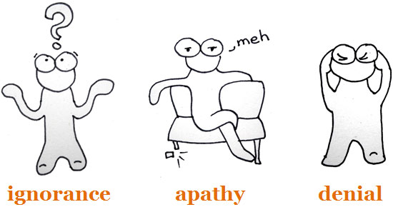
About me
Ignorant
2002+ Educated and aware
Commitment
2012 Champion
Read about Making accessibility part of culture change: it's all in the attitude on Access iQ™. Image credit: Ruth Ellison and Kim Chatterjee

Slide 3
WAI-ARIA
Accessible Rich Internet Applications
(from the W3C Web Accessibility Initiative)
Notes:
Developed by the Protocols and Formats Working Group, which is part of the World Wide Web Consortium (W3C) Web Accessibility Initiative (WAI)
ARIA is a W3C Candidate Recommendation on 18 Jan 2011

Slide 4
The problem
HTML is really only meant for static content
Javascript rides to the rescue!
Dynamic interactions!
Widgets!
But assistive technologies don’t understand dynamic interactions and widgets

Slide 5
Accessibility interoperability at a DOM Node without JavaScript
Role
States
Actions
Caret
Selection
Text
Hypertext
Value
Name
Description
Children
Changes
Relations
Data
Assistive Technology
UI
component
Contract
UI
From WAI-ARIA Primer

Slide 6
Accessibility interoperability at a DOM Node with JavaScript
^Role
^States
^Actions
Caret
Selection
Text
Hypertext
^Value
Name
Description
Children
^Changes
^Relations
Data
Assistive Technology
UI
component
Contract
UI
From WAI-ARIA Primer

Slide 7
WAI-ARIA
WAI-ARIA roles
Abstract, widget, document structure and landmark roles
WAI-ARIA states and properties
Widget, live region, drag-and-drop and relationship attributes

Slide 8
What we are looking at today
WAI-ARIA for page structure
WAI-ARIA live regions
WAI-ARIA to enhance keyboard navigation
WAI-ARIA for forms
WAI-ARIA for widgets

Slide 9
WAI-ARIA is the bridge

Slide 10
Roles
Describe the purpose of an object
Abstract roles (general role concepts, not to be used)
Widget roles (user interface widgets)
Document structure roles (content structure)
Landmark roles (webpage structure)

Slide 11
Widget roles
alert, alertdialog, button, checkbox, dialog, gridcell, link, log, marquee, menuitem, menuitemcheckbox, menuitemradio, option, progressbar, radio, scrollbar, slider, spinbutton, status, tab, tabpanel, textbox, timer, tooltip, treeitem

Slide 12
Document structure roles
article, columnheader, definition, directory, document, group, heading, img, list, listitem, math, note, presentation, region, row, rowheader, separator, toolbar

Slide 13
Landmark roles
application, banner, complementary, contentinfo, form, main, navigation, search

Slide 14
States and properties
Provide specific information about an object
Define the nature of a role
Widget Attributes
Live Region Attributes
Drag-and-Drop Attributes
Relationship Attributes

Slide 15
States
Describe the dynamic properties of an object that may change in response to a user action, or automated process
For example:
aria-checked, aria-disabled
aria-expanded, aria-invalid
Notes:
A state is a dynamic property expressing characteristics of an object that may change in response to user action or automated processes. States do not affect the essential nature of the object, but represent data associated with the object or user interaction possibilities.

Slide 16
Properties
Describe the nature of an object, or a data value associated with the object
For example:
aria-label, aria-labelledby
aria-live, aria-multiselectable, aria-readonly
Notes:
Attributes that are essential to the nature of a given object, or that represent a data value associated with the object.

Slide 17
Keyboard access
Assign tabindex (includingtabindex=-1) to any element for greater keyboard control

Slide 18
WAI-ARIA for page structure

Slide 20
<div role=”banner”>
<form role=”search”>
<div role= ”navigation”
<div role=”main”>
<div role= ”complementary”
<div role=”form”>
<div role=”application”>
<div role=”contentinfo”>
Notes:
Only use banner, contentinfo and main once within a document or application

Slide 21
Differentiate landmarks with the same type
Use aria-label to differentiate between regions with the same landmark type
<div role=“navigation” aria-label=“main menu”>
<div role=“navigation” aria-label=“sub menu”>

Slide 22
Assistive technology support
Jaws 11/12/13 has complete support.
ChromeVox has complete support
VoiceOver supports all landmarks except “form”
NVDA supports all landmarks except “application” and “form”
Window Eyes does not support ARIA landmarks
Latest ARIA landmark role support data, The Paciello Group (Nov 2011)

Slide 24
WAI-ARIA and forms

Slide 25
aria-required
Use aria-required=“true” for required form fields
<label for="name"> First Name</label>:
<input name="name" id="name" aria-required="true"> <em>(required)</em>

Slide 26
aria-describedby
Use aria-describedby to provide supporting information for an input field
<input type=“password"
id=“pwd“ aria-describedby=“pwd-reqs“ />
<p id=“pwd-reqs”>Your password must be 8 characters in length and include one number</p>

Slide 27
aria-invalid
<label for=“firstname">First name</label>:
<input name=“firstname" id=“firstname" aria-invalid="true">

Slide 28
aria-label and aria-labelledby
The purpose of aria-label and aria-labelledby are the same
Use aria-labelledby if the label text is visible on the screen
Use aria-label if the label text isn’t visible on the screen
Notes:
If the label text is visible on screen, authors SHOULD use aria-labelledby and SHOULD NOT use aria-label

Slide 29
Aria-labelledby
<label id="label" for="time">Self destruct this page in </label>
<input id="time" type="text" aria-labelledby="label time seconds" size="2" value="5">
<span id="seconds"> seconds</span>
Example from WebAIM: http://webaim.org/presentations/2012/ahgaria/labelledby3

Slide 30
WAI-ARIA live regions

Slide 31
ARIA live regions (priority)
aria-live=“off”
Updates are not announced to the user
aria-live=“polite”
Updates only announced if user is idle
aria-live=“assertive”
Updates are announced ASAP, but user is not interrupted

Slide 32
ARIA live regions (relevance)
aria-busy (values: true, false)
AT will only announced changes once aria-busy=“false”
aria-atomic (values: true, false)
Read out only the change, or the entire live region
aria-relevant (values: additions, removals, text)
Relevant changes to live regions depends on value

Slide 33
Special ARIA live regions
alert one-time notification
Status updated periodically w/ web app status
timer time elapsed or time remaining
marquee scrolling text (e.g. stock ticker)
log new information (e.g. chat program)

Slide 34
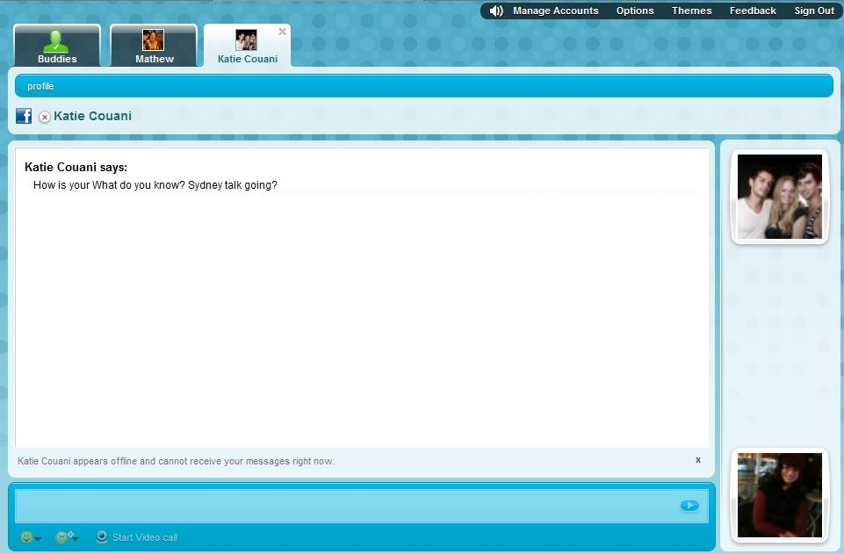
<div … role=“application">
<div id="container-contacts“ aria-live="assertive">
<div aria-live="assertive" role="log">
Notes:
eBuddy is using both landmark roles and live regions to assist their users.
The aria-live value of ‘assertive’ results in the user being alerted to the content change immediately, or as soon as possible.

Slide 35
WAI-ARIA for widgets

Slide 36
http://www.paciellogroup.com/blog/misc/ARIA/slider/

Slide 37
<button aria-valuetext="61%" aria-valuenow="61" aria-valuemax="100" aria-valuemin="0" aria-labelledby="sliderLabel" role="slider" id="sliderThumb1" class="sliderThumb" style="left: 113px;"> </button>
http://www.paciellogroup.com/blog/misc/ARIA/slider/

Slide 38
http://www.paciellogroup.com/blog/misc/samples/aria/slider/doubleslider.html

Slide 39
ARIA validation
ARIA attributes don’t validate in HTML4
Use the HTML5 DOCTYPE with ARIA markup
Validate using the W3C Nu Markup Validation Service

Slide 40
Take-aways
Dynamic content no longer has to be inaccessible to assistive technologies
Start using ARIA now (if you aren’t already)
Easy wins (landmark roles, forms)
It’s kinda fun!

Slide 41
Session evaluation
Creating dynamic and accessible content in Drupal 7 using WAI-ARIA

Slide 42
W3C WAI-ARIA documents
WAI-ARIA technical specification
http://www.w3.org/TR/wai-aria/
WAI-ARIA Primer
http://www.w3.org/TR/wai-aria-primer
WAI-ARIA Authoring Practices
http://www.w3.org/TR/wai-aria-practices

Slide 43
Useful WAI-ARIA resources
Using ARIA in HTML
http://bit.ly/Qz3DHs
Introduction to WAI-ARIA (Opera)
http://bit.ly/116YOW
The Paciello Group Blog
http://www.paciellogroup.com/blog

Slide 44
Level 3, 616-620 Harris St
Ultimo NSW 2007
t: +61 2 8218 9320
e: knowhow@accessiq.org
@accessiq
accessiq.org
Web accessibility know how

